Slide 2
Upgrading from .NET Framework to .NET 7
Olia Gavrysh
Mike Rousos
Taylor Southwick

Slide 3



Olia Gavrysh
Mike Rousos
Taylor Southwick
Senior Program Manager Microsoft
Principal Software Engineer Microsoft
Principal Software Engineer Microsoft

Slide 4
Agenda
Different versions of .NET
Why upgrade?
Modernization path for every app type
Deep dive into upgrade process
(on Web App example)

Slide 5
Different versions of .NET
.NET Framework
“The platform” going forward
Flexible deployment
Unparalleled performance
Reduced infrastructure & hosting costs
Modern, innovative languages and APIs
.NET
.NET Core
Mono / Xamarin
Notes:
Animated slide
Before there were many different .NETs: .NET Framework, .NET Core, .NET Standard, Mono/Xamarin. And we wanted to simplify the choices for .NET developers and provide a single stack that supports the best of breed solutions for all modern workloads and operating systems. We’ve taken the best of all the existing platforms into a platform called “.NET”. It starts with version number 5 because this is the highest number …
.NET 5 is the platform of .NET going forward, meaning that all new changes and improvements we will be done in .NET5.
.NET Framework is not going anywhere…
And besides being “the platform”, .NET 5 is much better than .NET Framework in many aspects such as deployment options, performance, and many others. In the scope of this talk let’s see why .NET 5 is a great choice for client apps.
<CLICK>

Slide 6
.NET Schedule
Dec 2019
.NET Core 3.1
LTS
Nov 2020
.NET 5.0
STS
Nov 2021
.NET 6.0
LTS
Nov 2022
.NET 7.0
STS
Nov 2023
.NET 8.0
LTS
Nov 2024
.NET 9.0
STS
Major releases every year
LTS for even numbered releases
Predictable schedule, minor releases as needed

Slide 7






Why upgrade?
.NET is “the platform” going forward
Performance improvements
Latest language & API enhancements (C# 11)
New modern controls
Accessibility support
Self-contained, single file EXEs
Improvements in ASP.NET, WinForms, WPF, EF, etc.
.NET 5
250+
.NET 6
550+
.NET 7
1000+
Notes:
Perf
Since the launch of .NET Core, we have been publishing a blog or maybe I should call this a book of performance improvements with each release of .NET.
For .NET 7, Stephen Toub recently published a 255 page blog detailing all the performance goodness that comes with .NET 7. A thousand performance-impacting PRs went into runtime and core libraries this release, never mind all the improvements in ASP.NET Core and Windows Forms and Entity Framework and beyond. It’s the fastest .NET ever. Will definitely recommend checking that out as well as his session tomorrow at 9:00 AM to learn more about the various perf enhancements coming with .NET 7.
C#
Simplify and write less code with C#11
Web
In .NET 7 we have continued our commitment to simplification by continuing to reduce complexity in major parts of our stack like Authentication. Starting with .NET 7 Preview 5 we made it simpler to configure authentication and authorization for you ASP.NET application with our JWT bearer authentication global tool.
Latest trends with support for new protocols like HTTP /3 and investment in HTTP/2 upload speed.
We have also introduced built-in Rate limiting that provides a way to protect a resource in order to avoid overwhelming your app and keep traffic at a safe level.
EF
EF7 addresses some of the most requested features.
For users storing document data as JSON in their relational databases, EF7 provides the bridge to query and update the content of those documents the same way developers are used to working with Cosmos DB to make it seamless
Again, like many other areas, we also focused on performance. From the graph on the right you can see how we have substantially reduced the time to insert multiple rows via enhancements to EF Core’s update pipeline, where it now supports mass update/delete scenarios without having to load individual items into memory

Slide 8

Every app can upgrade to the latest .NET
WinForms,
upgrade to .NET 7 with https://aka.ms/dotnet/upgrade
WPF
UWP upgrade to WinUI 3 (separate sessions on WinUI 3)
Xamarin.Forms upgrade to .NET MAUI (separate session)
WCF upgrade to .NET 7 with Core WCF (separate session)
ASP.NET upgrade to ASP.NET Core (this session and separate session)
libraries if used from both .NET Framework and .NET, keep on .NET Standard2.0; if only from .NET 7, upgrade to .NET 7
Notes:
Mention that we’ll talk about new tooling for ASP.NET upgrade scenarios in this session and that J. Tower will cover the scenario in even more depth in a later session.

Slide 9
Other migration sessions
Olia – In Progress
Wednesday, Nov 9
Using CoreWCF to unblock modernization of WCF apps
Sam Spencer, Matt Connew
16:00 PST
Upgrading Xamarin apps to .NET MAUI
Sweekriti Satpathy
17:00 PST
Migrate Your Legacy ASP.NET Projects to ASP.NET Core Incrementally with YARP
Jonathan "J." Tower
20:30 PST
Thursday, Nov 10
Leveling up data: Upgrade from EF6 to EF7 and blast off!
Arthur Vickers, Shay Rojansky
9:30 PST
Notes:
Our vision for .NET is to simplify the platform and choices for developers and provide a single stack that supports the best of breed solutions and developer productivity for all modern workloads.
.NET 7 is built around four core pillars: Unified, Modern, Simple and Productive.
A Unified platform
That has best in breed support for modern workloads
Is simple for new developers to learn and existing developers to learn more
And is the most productive platform to code on, with the best tooling.
---
.NET 7 comes with full native support for ARM64.
.NET is now included by default in Ubuntu package feed, available in chiseled Ubuntu containers, and has built in support for tar archives.
.NET 7 makes it easy to build and deploy distributed cloud native applications, while using container first workflows.
With a single codebase, you can now build applications that target mobile and desktop.
.NET 7 delivers on our simplification promise via C# 11 and several enhancements across the stack
And last but not the least, with .NET7 , we have delivered several performance improvements across all supported workloads
While we won’t have the time to go through everything that is new in .NET7, let’s look at a few highlights.

Slide 10
High-level upgrade workflow
Identify dependencies
.NET APIs
NuGet packages
Project-to-project
Loose binaries
Upgrade project and NuGet references
Upgrade in-place
Upgrade incrementally
Upgrade source code (and other project assets)
.NET Upgrade Assistant and Incremental Migration Tooling can help
Test and deploy!
Some changes are only visible at runtime
Especially important for cross-platform migration
Notes:
The details of how you upgrade will vary depending on the project
But the overall flow will always follow these main steps
*Walk through bullet points*
Highlight in-place/incremental as an important decision that will be covered on subsequent slides
Deployment options:
Self-contained or framework-dependent
Single-file exe
Cross-platform (depending on app model)

Slide 11
Upgrading in-place
Web App 1
Library 1
Library 2
Library 3
Library 4
Library 6
Library 5

Slide 12
Upgrading in-place
Projects updated in-place to .NET Standard or multi-targeted between .NET 7 and .NET Framework
Fastest path to full migration
Prevents duplicate code
Recommended for non-ASP.NET scenarios
Supported by .NET Upgrade Assistant
https://learn.microsoft.com/dotnet/core/porting/upgrade-assistant-overview
https://github.com/dotnet/upgrade-assistant
Web App 1
Library 1
Library 2
Library 3
Library 4
Library 6
Library 5 .NET Standard
Notes:
List scenarios that in-place upgrade is recommended for:
Windows desktop
Xamarin
Console / Windows services
Most class libraries

Slide 13
Upgrading incrementally
Web App 1
Library 1
Library 2
Library 3
Library 4
Library 6
Library 5

Slide 14
Upgrading incrementally
New projects created; implementation moved over gradually
Allows building/deploying app while migrating
Recommended ASP.NET scenarios or for very large class libraries with separable use-cases
Supported by VS extension for incremental migration
https://devblogs.microsoft.com/dotnet/migrating-from-asp-net-to-asp-net-core-part-4/
https://github.com/dotnet/systemweb-adapters
Web App 1 .NET 7
Library 1
Library 2
Library 3
Library 4
Library 6
Library 5
Web App 1
Library 5 .NET Standard
Notes:
Note that multiple head projects obviously doesn’t work for many project types (Windows Desktop, console, etc.)
But it can work for ASP.NET projects by using a reverse proxy in the new project.

Slide 15
Incremental Migration Tooling for Visual Studio
Automates creating new ASP.NET Core projects alongside existing ASP.NET projects
Automatically configures proxy between the apps
Apps are launched, debugged, and deployed together
Automates moving controllers and their dependencies from the old app to new
Applies some automatic code fixes like .NET Upgrade Assistant
External traffic
ASP.NET Core App
Business Logic
ASP.NET Core App
Business Logic
ASP.NET App

Slide 16
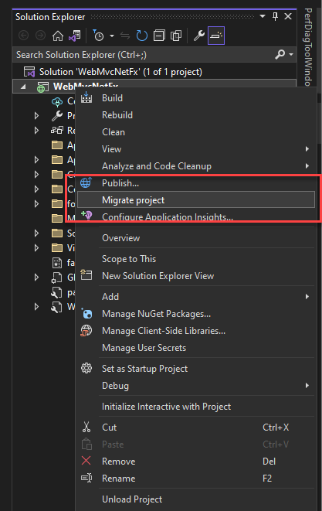
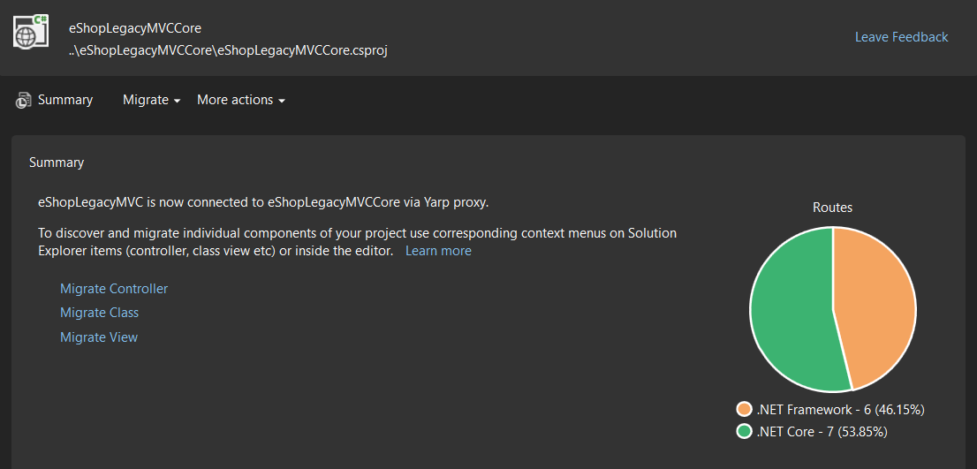
Incremental Upgrade experience
Related session:
Migrate Your Legacy ASP.NET Projects to ASP.NET Core Incrementally with YARP
Notes:
Migrate Your Legacy ASP.NET Projects to ASP.NET Core Incrementally with YARP is at 8:30 PM PST

Slide 17
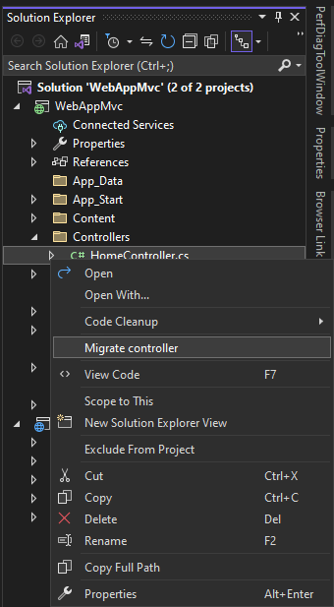
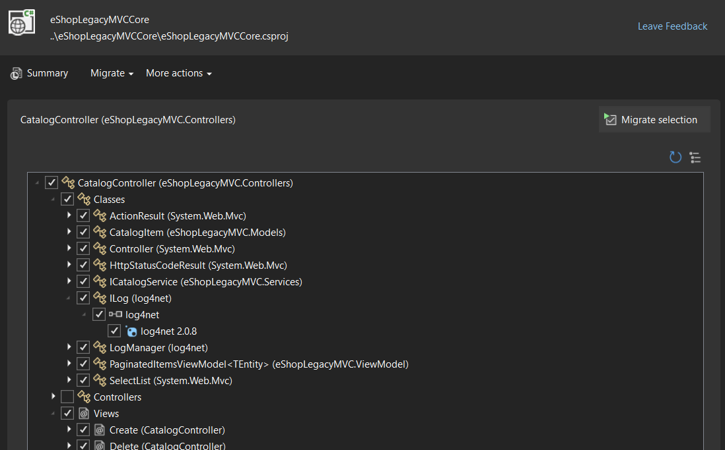
Incremental Upgrade experience
https://marketplace.visualstudio.com/items?itemName=WebToolsTeam.aspnetprojectmigrations
Notes:
Migrate Your Legacy ASP.NET Projects to ASP.NET Core Incrementally with YARP is at 8:30 PM PST

Slide 18
Incremental Migration Tooling vs. .NET Upgrade Assistant
.NET Upgrade Assistant
TODO
VS Extension for Incremental Migration
TODO

Slide 19
Incremental Migration Tooling Demo

Slide 20
Adapters for System.Web
Migrate business logic that relies on System.Web APIs such as HttpContext, HttpRequest, etc.
Use middleware and services that enable some key System.Web scenarios
Fully buffers InputStream
Enforce a logical single threaded environment
Enables strongly-typed session APIs
Provides helpers for use in incremental migration for session and authentication
Compile to .NET Standard 2.0 and run on ASP.NET Framework and ASP.NET Core
Implicit cast conversions are used to seamlessly transition between System.Web.HttpContext and Microsoft.AspNetCore.Http.HttpContext
On ASP.NET Framework, types are forwarded to those in-box on System.Web.dll
On ASP.NET Core, types are backed by ASP.NET Core types
Adapters are a thin, pass-through implementation to facilitate conversion between representations

Slide 21
System.Web Adapters
public static bool IsEnabled()
{
var context = System.Web.HttpContext.Current;
if (context.Session?["isEnabled"] is bool b)
{
return b;
}
if (ProcessHeader(context))
{
return true;
}
if (context.Request.Path.StartsWith("prod"))
{
return true;
}
return false;
}
public static bool ProcessHeader(Microsoft.AspNetCore.Http.HttpContext context)
{
if (context.Request.Headers.TryGetValue("X-Custom-Header", out var header))
{
return header == "Expected";
}
return false;
}
public static bool IsEnabled()
{
var context = System.Web.HttpContext.Current;
if (context.Session?["isEnabled"] is bool b)
{
return b;
}
if (context.Request.Headers["X-Custom-Header"] == "Expected")
{
return true;
}
if (context.Request.Path.StartsWith("prod"))
{
return true;
}
return false;
}
Access to many types from System.Web
Enabled libraries to migrate without total rewrite
Can alternate between representations
Is great for code deeply integrated with System.Web
Allows for more incremental migration to ASP.NET Core

Slide 22
Demo

Slide 23

Call to action
Get .NET 7! get.dot.net/7
Upgrade your apps!
WPF, WinForms, libraries: use Upgrade Assistant aka.ms/dotnet/upgrade
ASP.NET: aka.ms/dotnet/upgrade-asp, repo github.com/dotnet/systemweb-adapters
Xamarin.Forms: aka.ms/dotnet/upgrade-xamarin
UWP: aka.ms/dotnet/upgrade-uwp
Check out other sessions on migration!
Give us feedback in Visual Studio or at github.com/dotnet/upgrade-assistant

